Slide 1
Topics to Cover
Introduction
Substitution Ciphers
Transposition Ciphers
Stream and Block Ciphers

Slide 2
INTRODUCTION

Slide 3
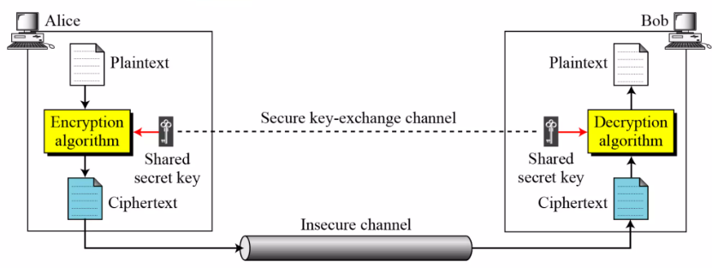
Symmetric Cipher Model

Slide 4
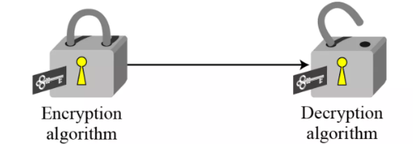
Symmetric Cipher Model (Contd..)
Alice:- C = E_{k}(P)
Bob:- D = D_{k}(C) = D_{k}(E_{k}(P))

Slide 5
Kerckhoff’s Principle
Published by Auguste Kerckhoff in 1883.
Uses 2 key principles:- Algorithm Transparency, and Key Secrecy

Slide 6
3 Independent Dimensions of Cryptographic Systems
Types of Operations used for transformation of PT to CT
Number of keys used
How PT is processed

Slide 7
Cryptanalysis Techniques on Encrypted Data
Brute Force Attack (BFA)
Statistical Attack
Pattern Attack
Ciphertext Only Attack
Known Plaintext Attack
Chosen Plaintext Attack
Chosen Ciphertext Attack

Slide 8
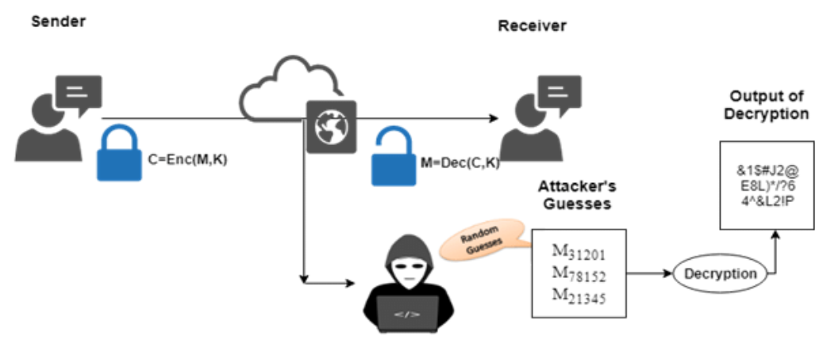
BFA

Slide 9

Statistical Attack
CT:-
The letter ‘e’ is the most frequently used English alphabet for plaintext.
Hence, for the above CT, the attacker makes a best case guess that most probably the ciphertext character ‘w’ maps to the plaintext character ‘e’.

Slide 10
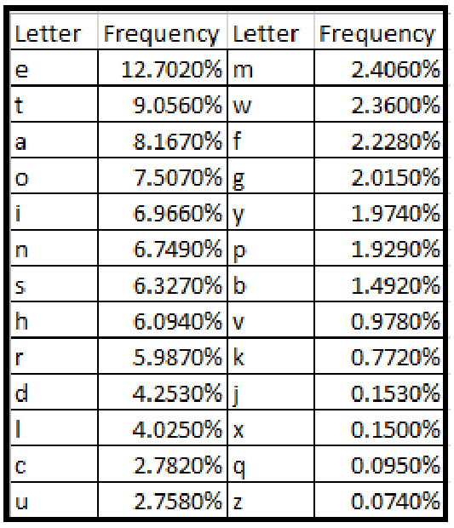
Statistical Attack (Contd..)

Slide 11


Pattern Attack

Slide 12
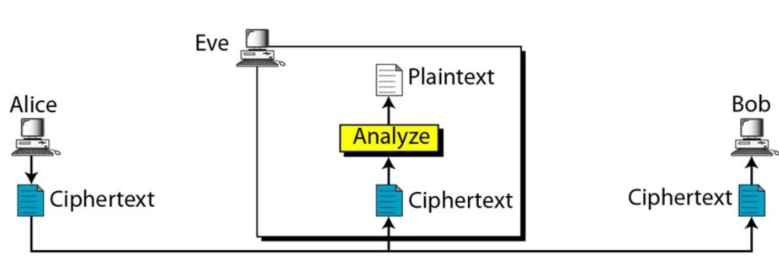
Ciphertext Only Attack

Slide 13
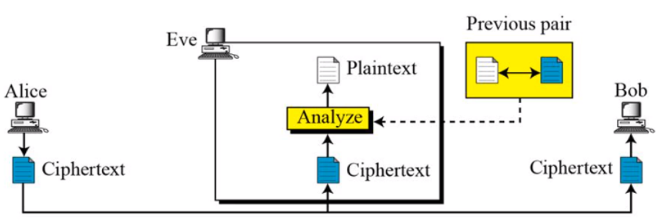
Known Plaintext Attack

Slide 14
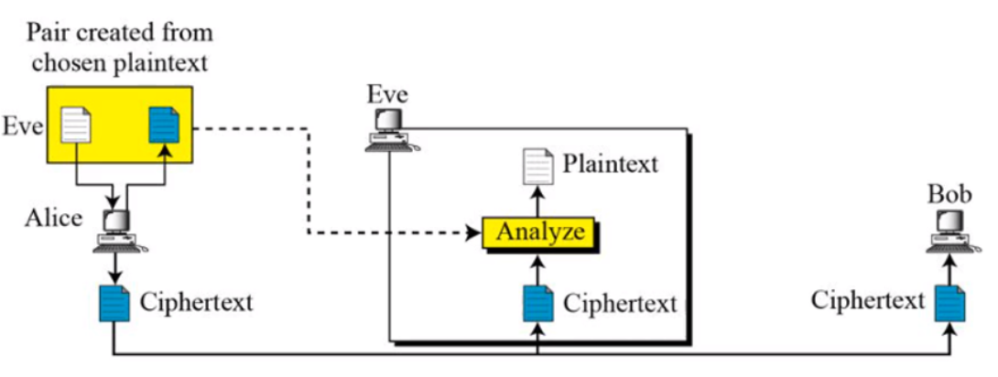
Chosen Plaintext Attack

Slide 15
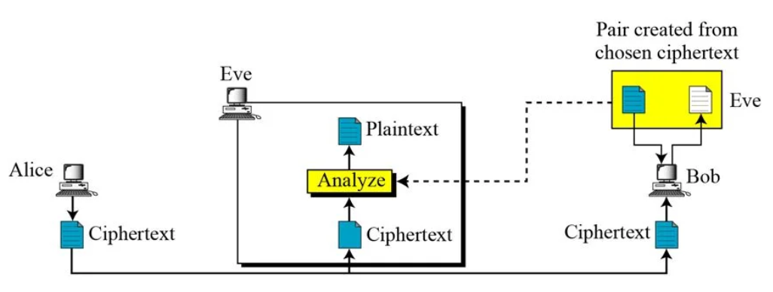
Chosen Ciphertext Attack

Slide 16
Classical Ciphers
Substitution
Transposition
Monoalphabetic
Polyalphabetic
Rail Fence
Columnar
Hill
Additive Cipher
Vigenere
Permutation
Vernam
Multiplicative Cipher
Autokey
Route
Affine Cipher
Playfair

Slide 17
Default Numerical Values
Character | Numerical Equivalent | Character | Numerical Equivalent
a | 0 | n | 13
b | 1 | o | 14
c | 2 | p | 15
d | 3 | q | 16
e | 4 | r | 17
f | 5 | s | 18
g | 6 | t | 19
h | 7 | u | 20
i | 8 | v | 21
j | 9 | w | 22
k | 10 | x | 23
l | 11 | y | 24
m | 12 | z | 25

Slide 18
SUBSTITUTION CIPHERS

Slide 19
Additive Cipher

Slide 20
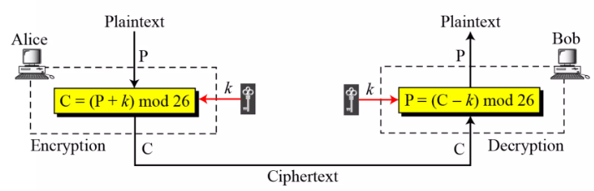
Additive Cipher
Also called as Shift cipher.
Here the key, PT and CT are in Z₂₆.

Slide 21
Numerical 1
Encrypt the message “manipal” using key = 13, and additive cipher in Z₂₆. Assume that the alphabets are case-insensitive and use the default numerical equivalents.
Solution:-
m | a | n | i | p | a | l
12 | 0 | 13 | 8 | 15 | 0 | 11
c = (p+k) mod 26 = (p+13) mod 26

Slide 22
Numerical 1 (Contd..)
25 | 13 | 0 | 21 | 2 | 13 | 24
z | n | a | v | c | n | y
Therefore, the encrypted message is znavcny.

Slide 23
Numerical 2
Decrypt the message “znavcny” using key = 13, and additive cipher in Z₂₆. Assume that the alphabets are case-insensitive and use the default numerical equivalents.
Solution:-
z | n | a | v | c | n | y
25 | 13 | 0 | 21 | 2 | 13 | 24
d = (c-k) mod 26 = (c-13) mod 26

Slide 24
Numerical 2 (Contd..)
12 | 0 | 13 | 8 | 15 | 0 | 11
m | a | n | i | p | a | l
Therefore, the decrypted message is manipal.

Slide 25
Numerical 3
Assume that Additive cipher is used with some special characters with their corresponding numerical equivalents as displayed in the table below. Assume that the alphabets which are used are case-insensitive and use the default numerical equivalents. Decrypt the ciphertext “>d@$d>>h$d@w” using key = 23.
Special Characters | Numerical Equivalents
? | 26
> | 27
< | 28
@ | 29
# | 30
$ | 31
! | 32

Slide 26
Numerical 3 (Contd..)
> (27) → {d = (c-23) mod 33} → 4 (e)
d (3) → {d = (c-23) mod 33} → 13 (n)
@ (29) → {d = (c-23) mod 33} → 6 (g)
$ (31) → {d = (c-23) mod 33} → 8 (i)
d (3) → {d = (c-23) mod 33} → 13 (n)
> (27) → {d = (c-23) mod 33} → 4 (e)
> (27) → {d = (c-23) mod 33} → 4 (e)

Slide 27
Numerical 3 (Contd..)
h (7) → {d = (c-23) mod 33} → 17 (r)
$ (31) → {d = (c-23) mod 33} → 8 (i)
d (3) → {d = (c-23) mod 33} → 13 (n)
@ (29) → {d = (c-23) mod 33} → 6 (g)
w (22) → {d = (c-23) mod 33} → 32 (!)
Therefore, the decrypted text is engineering!

Slide 28
Digrams on Additive Ciphers
Pairs of alphabets or characters are encrypted or decrypted.
Most commonly used digrams in plaintexts are ‘th’, ‘he’, ‘in’, etc.
c = (p+k) mod 676, when only alphabets are used by ignoring the case.
d = (c-k) mod 676, when only alphabets are used by ignoring the case.

Slide 29
Additive Cipher with digram (Numerical 1)
Encrypt the message software using key = 500, and additive cipher using digrams. Assume that the alphabets are case-insensitive and use the default numerical equivalents.
Solution:-
so | ft | wa | re
26*18+14 = 482 | 26*5+19 = 149 | 26*22+0 = 572 | 26*17+4 = 446

Slide 30
Additive Cipher with digram (Numerical 1) (Contd..)
c = (p+k) mod 676 = (p+500) mod 676
306 = 26*11+20 | 649 = 26*24+25 | 396 = 26*15+6 | 270 = 26*10+10
lu | yz | pg | kk
The ciphertext is luyzpgkk.

Slide 31
Additive Cipher with digram (Numerical 2)
Decrypt the message luyzpgkk using key = 500, and additive cipher using digrams. Assume that the alphabets are case-insensitive and use the default numerical equivalents.
Solution:-
lu | yz | pg | kk
26*11+20 = 306 | 26*24+25 = 649 | 26*15+6 = 396 | 26*10+10 = 270

Slide 32
Additive Cipher with digram (Numerical 2) (Contd..)
p = (c-k) mod 676 = (c-500) mod 676
482 = 26*18+14 | 149 = 26*5+19 | 572 = 26*22+0 | 446 = 26*17+4
so | ft | wa | re
The decrypted text is software.

Slide 33
Caesar Cipher
c = (p+3) mod 26
d = (c-3) mod 26
Ciphertext corresponding to the plaintext “udupi” is “xgxsl”
Plaintext corresponding to the ciphertext “pdqlsdo” is “manipal”.
However, Caesar cipher is generalized as additive cipher to use key of any value.

Slide 34
Pros and Cons of Additive Cipher
Simple to understand, and Easy to implement.
Demands negligible computational resources.
Highly vulnerable to BFA.
Vulnerable to Statistical attack.

Slide 35
Multiplicative Cipher

Slide 36
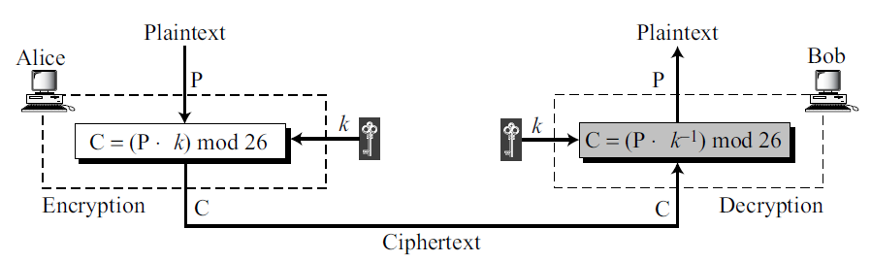
Multiplicative Cipher
PT characters are multiplied during encryption.
CT characters are multiplied by Multiplicative Inverse of the key mod 26.
Key should belong Z₂₆*

Slide 37
Numerical 1
Encrypt the message manipal using key = 15, and multiplicative cipher in Z₂₆. Assume that the alphabets are case-insensitive and use the default numerical equivalents.
Solution:-
m | a | n | i | p | a | l
12 | 0 | 13 | 8 | 15 | 0 | 11
c = (p*k) mod 26 = (p*15) mod 26

Slide 38
Numerical 1 (Contd..)
24 | 0 | 13 | 16 | 17 | 0 | 9
y | a | n | q | r | a | j
Therefore, the encrypted message is yanqraj.

Slide 39
Numerical 2
Decrypt the message yanqraj using key = 15, and multiplicative cipher in Z₂₆. Assume that the alphabets are case-insensitive and use the default numerical equivalents.
Solution:-
q | a | b | r | v1 | v2 | v
1 | 26 | 15 | 11 | 0 | 1 | -1
1 | 15 | 11 | 4 | 1 | -1 | 2
2 | 11 | 4 | 3 | -1 | 2 | -5
1 | 4 | 3 | 1 | 2 | -5 | 7
3 | 3 | 1 | 0 | -5 | 7 | -26

Slide 40
Numerical 2 (Contd..)
y | a | n | q | r | a | j
24 | 0 | 13 | 16 | 17 | 0 | 9
p = (c*k⁻¹) mod 26 = (c*7) mod 26
12 | 0 | 13 | 8 | 15 | 0 | 11
m | a | n | i | p | a | l
Therefore, the decrypted message is manipal.

Slide 41
Numerical 3
Decrypt the message qswmraf using key = 11, and multiplicative cipher in Z₂₆. Assume that the alphabets are case-insensitive and use the default numerical equivalents.
Solution:-
q | a | b | r | v1 | v2 | v
2 | 26 | 11 | 4 | 0 | 1 | -2
2 | 11 | 4 | 3 | 1 | -2 | 5
1 | 4 | 3 | 1 | -2 | 5 | -7
3 | 3 | 1 | 0 | 5 | -7 | 26

Slide 42
Numerical 3 (Contd..)
q | s | w | m | r | a | f
16 | 18 | 22 | 12 | 17 | 0 | 5
p = (c*k⁻¹) mod 26 = (c*-7) mod 26
18 | 4 | 2 | 20 | 11 | 0 | 17
s | e | c | u | l | a | r
Therefore, the decrypted message is secular.

Slide 43
Pros and Cons of Multiplicative Cipher
Simple to understand, and Easy to implement.
Demands negligible computational resources.
More complex mapping than a simple shift.
Highly vulnerable to BFA.
Vulnerable to Statistical attack.
Validity of the keys should be tested.

Slide 44
Affine Cipher

Slide 45
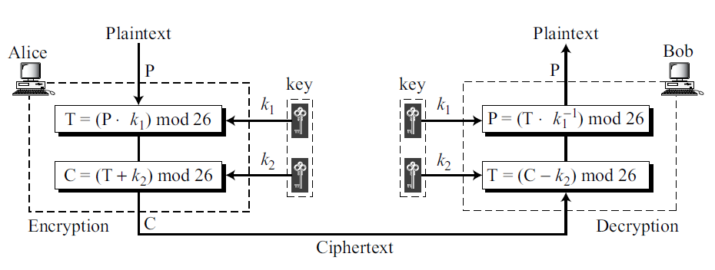
Affine Cipher
Combination of Additive and Multiplicative Cipher
k₁ should belong Z₂₆* and k₂ belongs to Z₂₆

Slide 46
Numerical 1
Encrypt the message manipal using the key pair k₁ = 17 and k₂ = 4, and affine cipher in Z₂₆. Assume that the alphabets are case-insensitive and use the default numerical equivalents.
Solution:-
m | a | n | i | p | a | l
12 | 0 | 13 | 8 | 15 | 0 | 11
c = [p*k₁+k₂] mod 26 = (p*17+4) mod 26

Slide 47
Numerical 1 (Contd..)
0 | 4 | 17 | 10 | 25 | 4 | 9
a | e | r | k | z | e | j
Therefore, the encrypted message is aerkzej.

Slide 48
Numerical 2
Encrypt the message aerkzej using the key pair k₁ = 17 and k₂ = 4, and affine cipher in Z₂₆. Assume that the alphabets are case-insensitive and use the default numerical equivalents.
Solution:-
a | e | r | k | z | e | j
0 | 4 | 17 | 10 | 25 | 4 | 9
p = [(c-k₂)*k₁⁻¹] mod 26 = [(c-4)*23] mod 26

Slide 49
Numerical 2 (Contd..)
12 | 0 | 13 | 8 | 15 | 0 | 11
m | a | n | i | p | a | l
Therefore, the decrypted message is manipal.

Slide 50
Numerical 3
Decrypt the message nzoxdywn# using the key pair k₁ = 16 and k₂ = 15, and affine cipher using character set of alphabets (excluding the case) with their default numerical equivalents and some special characters (Refer Slide 25)
Solution:-
n | z | o | x | d | y | w | n | #
13 | 25 | 14 | 23 | 3 | 24 | 22 | 13 | 30
p = [(c-k₂)*k₁⁻¹] mod 26 = [(c-15)*31] mod 33

Slide 51
Numerical 3 (Contd..)
4 | 13 | 2 | 17 | 24 | 15 | 19 | 4 | 3
e | n | c | r | y | p | t | e | d
Therefore, the decrypted message is encrypted.

Slide 52
Pros and Cons of Affine Cipher
Simple to understand, and Easy to implement.
Demands negligible computational resources.
More resistant to BFA than Additive and Multiplicative Cipher
Highly vulnerable to BFA.
Vulnerable to Statistical attack.
Validity of the keys should be tested.

Slide 53
Vigenere Cipher

Slide 54
Vigenere Cipher
The length of the key is made equal to that of the plaintext or ciphertext if it’s not the case already.
k = [(k₀, k₁, k₂, ……,k_{m-1}), (k₀, k₁, k₂, ……,k_{m-1}),…….]
c_{i} = (p_{i} + k_{i} _{mod m}) mod 26
p_{i} = (c_{i} – k_{i} _{mod m}) mod 26
Typically, m is lesser than the length of plaintext or ciphertext.

Slide 55
Numerical 1
Encrypt the plaintext karnataka using Vigenere Cipher and the key hello. Assume that only alphabets are used by ignoring the case.
Solution:-
PT | k (10) | a (0) | r (17) | n (13) | a (0) | t (19) | a (0) | k (10) | a (0)
+
Key | h (7) | e (4) | l (11) | l (11) | o (14) | h (7) | e (4) | l (11) | l (11)
(mod 26) =

Slide 56
Numerical 1 (Contd..)
CT | 17 (r) | 4 (e) | 2 (c) | 24 (y) | 14 (o) | 0 (a) | 4 (e) | 21 (v) | 11 (l)
Therefore, the ciphertext is recyoaevl.

Slide 57
Numerical 2
Decrypt the ciphertext recyoaevl using Vigenere Cipher and the key hello. Assume that only alphabets by ignoring the case.
Solution:-
CT | r (17) | e (4) | c (2) | y (24) | o (14) | a (0) | e (4) | v (21) | l (11)
-
Key | h (7) | e (4) | l (11) | l (11) | o (14) | h (7) | e (4) | l (11) | l (11)
(mod 26) =

Slide 58
Numerical 2 (Contd..)
PT | 10 (k) | 0 (a) | 17 (r) | 13 (n) | 0 (a) | 19 (t) | 0 (a) | 10 (k) | 0 (a)
Therefore, the decrypted text is karnataka.

Slide 59
Numerical 3
Decrypt the ciphertext yitpiyxugubnmtf using Vigenere Cipher and the key manipal. Assume that the encryption/decryption is done using only alphabets by ignoring the case.
Solution:-
CT | y (24) | i (8) | t (19) | p (15) | i (8) | y (24) | x (23) | u (20) | g (6) | u (20) | b (1) | n (13) | m (12) | t (19) | f (5)
-
Key | m (12) | a (0) | n (13) | i (8) | p (15) | a (0) | l (11) | m (12) | a (0) | n (13) | i (8) | p (15) | a (0) | l (11) | m (12)
(mod 26) =

Slide 60
Numerical 3 (Contd..)
PT | 12 (m) | 8 (i) | 6 (g) | 7 (h) | 19 (t) | 24 (y) | 12 (m) | 8 (i) | 6 (g) | 7 (h) | 19 (t) | 24 (y) | 12 (m) | 8 (i) | 19 (t)
Therefore, the decrypted text is mightymightymit.

Slide 61
Pros and Cons of Vigenere Cipher
Simple to understand and easy to implement.
More resistant to statistical attack and pattern attack when compared to that of monoalphabetic ciphers.
When the PT is long, the cipher is resistant to BFA if the key is long enough.
Vulnerable to BFA if PT is extremely short.
Vulnerable to statistical attack if key length is significantly lesser than that of the plaintext.
Vulnerable to pattern attack if key length is significantly lesser than that of the plaintext.

Slide 62
Autokey Cipher

Slide 63
Autokey Cipher
Operation | Formulae
Keystream Generation | K₀ = chosen value; K_{i} = P_{i-1} for 1 ≤ i ≤ m-1
Encryption | C_{i} = (P_{i} + K_{i}) mod 26 for 0 ≤ i ≤ m-1
Decryption | P_{i} = (C_{i} − K_{i}) mod 26 for 0 ≤ i ≤ m-1

Slide 64
Numerical 1
Encrypt the plaintext karnataka using Autokey Cipher with key = 10. Assume that only alphabets are used by ignoring the case.
Solution:-
PT | k (10) | a (0) | r (17) | n (13) | a (0) | t (19) | a (0) | k (10) | a (0)
+
Key | 10 | k (10) | a (0) | r (17) | n (13) | a (0) | t (19) | a (0) | k (10)
(mod 26) =

Slide 65
Numerical 1 (Contd..)
CT | 20 (u) | 10 (k) | 17 (r) | 4 (e) | 13 (n) | 19 (t) | 19 (t) | 10 (k) | 10 (k)
Therefore, the ciphertext is ukrenttkk.

Slide 66
Numerical 2
Decrypt the ciphertext ukrenttkk using Autokey Cipher with key = 10. Assume that only alphabets are used by ignoring the case.
Solution:-
CT | u (20) | k (10) | r (17) | e (4) | n (13) | t (19) | t (19) | k (10) | k (10)
-
Key | 10 | K1 | K2 | K3 | K4 | K5 | K6 | K7 | K8
(mod 26) =

Slide 67
Numerical 2 (Contd..)
P0 = (20 - 10) mod 26 = 10 (k)
K1 = P0; P1 = (10 – 10) mod 26 = 0 (a)
K2 = P1; P2 = (17 – 0) mod 26 = 17 (r)
K3 = P2; P3 = (4 – 17) mod 26 = 13 (n)
K4 = P3; P4 = (13 - 13) mod 26 = 0 (a)
K5 = P4; P5 = (19 – 0) mod 26 = 19 (t)
K6 = P5; P6 = (19 – 19) mod 26 = 0 (a)
K7 = P6; P7 = (10 - 0) mod 26 = 10 (k)
K8 = P7; P8 = (10 - 10) mod 26 = 0 (a)
Therefore, the decrypted text is karnataka

Slide 68
Numerical 3
Decrypt the ciphertext rkrnwr using Autokey Cipher with key = 7. Assume that only alphabets are used by ignoring the case.
Solution:-
CT | r (17) | k (10) | r (17) | n (13) | w (22) | r (17)
-
Key | 7 | K1 | K2 | K3 | K4 | K5
(mod 26) =

Slide 69
Numerical 3 (Contd..)
P0 = (17 - 7) mod 26 = 10 (k)
K1 = P0; P1 = (10 – 10) mod 26 = 0 (a)
K2 = P1; P2 = (17 – 0) mod 26 = 17 (r)
K3 = P2; P3 = (13 – 17) mod 26 = 22 (w)
K4 = P3; P4 = (22 - 22) mod 26 = 0 (a)
K5 = P4; P5 = (17 – 0) mod 26 = 17 (r)
Therefore, the decrypted text is karwar

Slide 70
Pros and Cons of Autokey Cipher
Simple to understand and easy to implement.
More resistant to statistical attack and pattern attack when compared to that of monoalphabetic ciphers.
Dynamic Keystream generation.
Higher Probability of Error Propagation.
Efficiency reduces significantly for large plaintexts
Vulnerable to Known Plaintext attack

Slide 71
Playfair Cipher

Slide 72
Playfair Cipher
Invented by Charles Wheatstone in the year 1854.
Encrypts or decrypts digrams.
Key is a 5*5 matrix with all the alphabets (letters i and j are considered as a single entry appropriately) arranged row-wise.

Slide 73
Generation of key matrix from key
Initially the alphabets of the key are arranged row-wise in a 5*5 matrix, by removing duplicates from the key.
Rest of the vacancies of the matrix are filled with remaining alphabets.

Slide 74
Generation of key matrix from key (Example 1)
Consider that the key is UDUPI.
The corresponding key matrix will be:-
U | D | P | I | A
B | C | E | F | G
H | K | L | M | N
O | Q | R | S | T
V | W | X | Y | Z

Slide 75
Generation of key matrix from key (Example 2)
Consider that the key is JAIPUR.
The corresponding key matrix will be:-
I | A | P | U | R
B | C | D | E | F
G | H | K | L | M
N | O | Q | S | T
V | W | X | Y | Z

Slide 76
Steps for Processing Plaintexts
Plaintext is processed as each digram at a time.
Plaintext is modified (if necessary) to make sure that no digram has a duplicate alphabet (by replacing a duplicate alphabet by x).
Plaintext is modified (if necessary) to make sure that no alphabet is left unpaired (by adding x to the last alphabet of the original plaintext to make it form a digraph).
FEVER ➔ FEVERX
SHEEP ➔ SHEXEP
TEAM ➔ TEAM

Slide 77
Steps for Encrypting a Plaintext
If both the alphabets of a digram are in the same row, then each alphabet is replaced by the alphabet immediately towards its right (the alphabet in the last column is replaced by the alphabet in the first column).
If both the alphabets of a digram are in the same column, then each alphabet is replaced by the alphabet immediately below it respectively (the alphabet in the last row is replaced by the alphabet in the first row).
Else, in a digram each alphabet is replaced by the alphabet which is in the same row but in the column of the other alphabet of the digram.

Slide 78
Steps for Decrypting a Ciphertext
If both the alphabets of a digram are in the same row, then each alphabet is replaced by the alphabet immediately towards its left (the alphabet in the first column is replaced by the alphabet in the last column).
If both the alphabets of a digram are in the same column, then each alphabet is replaced by the alphabet immediately above it respectively (the alphabet in the first row is replaced by the alphabet in the last row).
Else, in a digram each alphabet is replaced by the alphabet which is in the same row but in the column of the other alphabet of the digram.

Slide 79
Numerical 1
Encrypt the plaintext CHENNAI using the key MANGALORE, using Playfair Cipher which uses only alphabets by ignoring the case.
Solution:-
Key matrix:-
Modified PT = CHENNAIX
M | A | N | G | L
O | R | E | B | C
D | F | H | I | K
P | Q | S | T | U
V | W | X | Y | Z

Slide 80
Numerical 1 (Contd..)
CH ➔ EK
EN ➔ HE
NA ➔ GN
IX ➔ HY
Therefore, the ciphertext is EKHEGNHY.

Slide 81
Numerical 2
Decrypt the ciphertext EKHEGNHY using the key MANGALORE, using Playfair Cipher which uses only alphabets by ignoring the case.
Solution:-
Key matrix:-
Modified CT = EKHEGNHY
M | A | N | G | L
O | R | E | B | C
D | F | H | I | K
P | Q | S | T | U
V | W | X | Y | Z

Slide 82
Numerical 2 (Contd..)
EK ➔ CH
HE ➔ EN
GN ➔ NA
HY ➔ IX
The decrypted text is CHENNAIX.
Therefore, the final decrypted text is CHENNAI.

Slide 83
Numerical 3
Encrypt the plaintext HELLOINDIA using the key PLAYFAIR, using Playfair Cipher which uses only alphabets by ignoring the case.
Solution:-
Key matrix:-
Modified PT = HELXLOINDIAX
P | L | A | Y | F
I | R | B | C | D
E | G | H | K | M
N | O | Q | S | T
U | V | W | X | Z

Slide 84
Example 3 (Contd..)
HE ➔ KG
LX ➔ YV
LO ➔ RV
IN ➔ EU
DI ➔ IR
AX ➔ YW
Therefore, the ciphertext is KGYVRVEUIRYW.

Slide 85
Pros and Cons of Playfair Cipher
Simple to understand and easy to implement when the plaintext length is even and when the original digrams don’t have duplicate alphabets.
BFA on the cipher is almost impossible.
Resistant to statistical and pattern attacks when the plaintexts are short.
Key Management is easy.
Implementation gets complicated when the plaintext length is odd, or if the original digrams have duplicate alphabets.
Vulnerable to statistical and pattern attacks when the plaintexts are long (> 1000 characters).

Slide 86
Hill Cipher

Slide 87
Hill Cipher
Developed by Lester Hill in 1929.
Uses concepts of Linear Algebra.
C = P * K (mod 26), where P is of order m*n, and K is of order n*n.
D = C * K⁻¹ (mod 26)
Note:- K is an invertible matrix, and GCD(det(K), 26) = 1

Slide 88
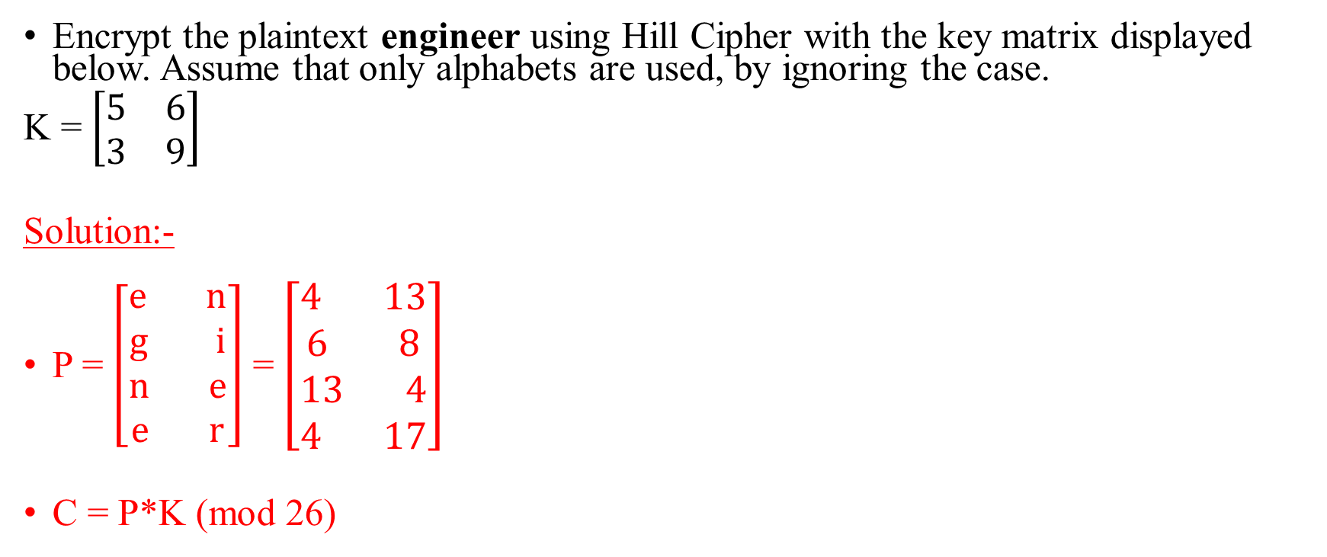
Numerical 1
Encrypt the plaintext engineer using Hill Cipher with the key matrix displayed below. Assume that only alphabets are used, by ignoring the case.
K = $\left[\begin{matrix}5 & 6 \\ 3 & 9\end{matrix}\right]$
Solution:-
P = $\left[\begin{aligned}e n \\ g i \\ n e \\ e r\end{aligned}\right]$ = $\left[\begin{aligned}4 13 \\ 6 8 \\ 13 4 \\ 4 17\end{aligned}\right]$
C = P*K (mod 26)

Slide 89

Numerical 1 (Contd..)
C = $\left[\begin{aligned}4 13 \\ 6 8 \\ 13 4 \\ 4 17\end{aligned}\right]$ * $\left[\begin{matrix}5 & 6 \\ 3 & 9\end{matrix}\right]$ (mod 26)
C = $\left[\begin{aligned}7 11 \\ 2 4 \\ 25 10 \\ 19 21\end{aligned}\right]$ = $\left[\begin{aligned}h l \\ c e \\ z k \\ t v\end{aligned}\right]$
Therefore, the ciphertext is hlcezktv.

Slide 90

Numerical 2
Decrypt the ciphertext hlcezktv using Hill Cipher with the key matrix displayed below. Assume that only alphabets are used, by ignoring the case.
K = $\left[\begin{matrix}5 & 6 \\ 3 & 9\end{matrix}\right]$
Solution:-
det(K) = 27
C = $\left[\begin{aligned}h l \\ c e \\ z k \\ t v\end{aligned}\right]$ = $\left[\begin{aligned}7 11 \\ 2 4 \\ 25 10 \\ 19 21\end{aligned}\right]$

Slide 91

Numerical 2 (Contd..)
K⁻¹ = $\left[\begin{matrix}9 & −6 \\ −3 & 5\end{matrix}\right]$* 27⁻¹ (mod 26)
K⁻¹ = $\left[\begin{matrix}9 & −6 \\ −3 & 5\end{matrix}\right]$* 1 (mod 26) = $\left[\begin{matrix}9 & 20 \\ 23 & 5\end{matrix}\right]$
q | a | b | r | u1 | u2 | u
1 | 27 | 26 | 1 | 1 | 0 | 1
26 | 26 | 1 | 0 | 0 | 1 | -26
 | 1 | 0 |  | 1 | -26

Slide 92

Numerical 2 (Contd..)
D = C*K⁻¹ (mod 26) = $\left[\begin{aligned}7 11 \\ 2 4 \\ 25 10 \\ 19 21\end{aligned}\right]$ * $\left[\begin{matrix}9 & 20 \\ 23 & 5\end{matrix}\right]$ (mod 26)
D = $\left[\begin{aligned}316 195 \\ 110 60 \\ 455 550 \\ 654 485\end{aligned}\right]$ (mod 26) = $\left[\begin{aligned}4 13 \\ 6 8 \\ 13 4 \\ 4 17\end{aligned}\right]$ = $\left[\begin{aligned}e n \\ g i \\ n e \\ e r\end{aligned}\right]$
Therefore, the decrypted text is engineer.

Slide 93

Numerical 3
Decrypt the ciphertext rrlmwbkaspdh using Hill Cipher with the key matrix displayed below. Assume that only alphabets are used, by ignoring the case.
K = $\left[\begin{matrix}17 & 17 & 5 \\ 21 & 18 & 21 \\ 2 & 2 & 19\end{matrix}\right]$
Solution:-
C = $\left[\begin{aligned}r r l \\ m w b \\ k a s \\ p d h\end{aligned}\right]$ = $\left[\begin{aligned}17 17 11 \\ 12 22 1 \\ 10 0 18 \\ 15 3 7\end{aligned}\right]$

Slide 94

Numerical 3 (Contd..)
K⁻¹ = $\left[\begin{matrix}300 & −313 & 267 \\ −357 & 313 & −252 \\ 6 & 0 & −51\end{matrix}\right]$ * (-939)⁻¹ (mod 26)
K⁻¹ = $\left[\begin{matrix}−300 & 313 & −267 \\ 357 & −313 & 252 \\ −6 & 0 & 51\end{matrix}\right]$ * (939)⁻¹ (mod 26)
K⁻¹ = $\left[\begin{matrix}−300 & 313 & −267 \\ 357 & −313 & 252 \\ −6 & 0 & 51\end{matrix}\right]$ * 9 (mod 26) = $\left[\begin{matrix}4 & 9 & 15 \\ 15 & 17 & 6 \\ 24 & 0 & 17\end{matrix}\right]$

Slide 95

Numerical 3 (Contd..)
D = C * K⁻¹ (mod 26) = $\left[\begin{aligned}17 17 11 \\ 12 22 1 \\ 10 0 18 \\ 15 3 7\end{aligned}\right]$ * $\left[\begin{matrix}4 & 9 & 15 \\ 15 & 17 & 6 \\ 24 & 0 & 17\end{matrix}\right]$ (mod 26)
D = $\left[\begin{aligned}587 442 544 \\ 402 482 329 \\ 472 90 456 \\ 273 186 362\end{aligned}\right]$ (mod 26) = $\left[\begin{aligned}15 0 24 \\ 12 14 17 \\ 4 12 14 \\ 13 4 24\end{aligned}\right]$ = $\left[\begin{aligned}p a y \\ m o r \\ e m o \\ n e y\end{aligned}\right]$
Therefore, the decrypted text is paymoremoney.

Slide 96
Pros and Cons of Hill Cipher
Simple and Easy to understand and implement with prior knowledge of linear algebra.
More resistant to statistical attack than that for any other monoalphabetic ciphers.
Use of matrices adds an additional level of security.
Limited key size and key space if 2*2 matrix is used as the key.
Poor efficiency for encrypting and decrypting data using large key matrices.

Slide 97
TRANSPOSITION CIPHERS

Slide 98
Rail Fence Cipher

Slide 99
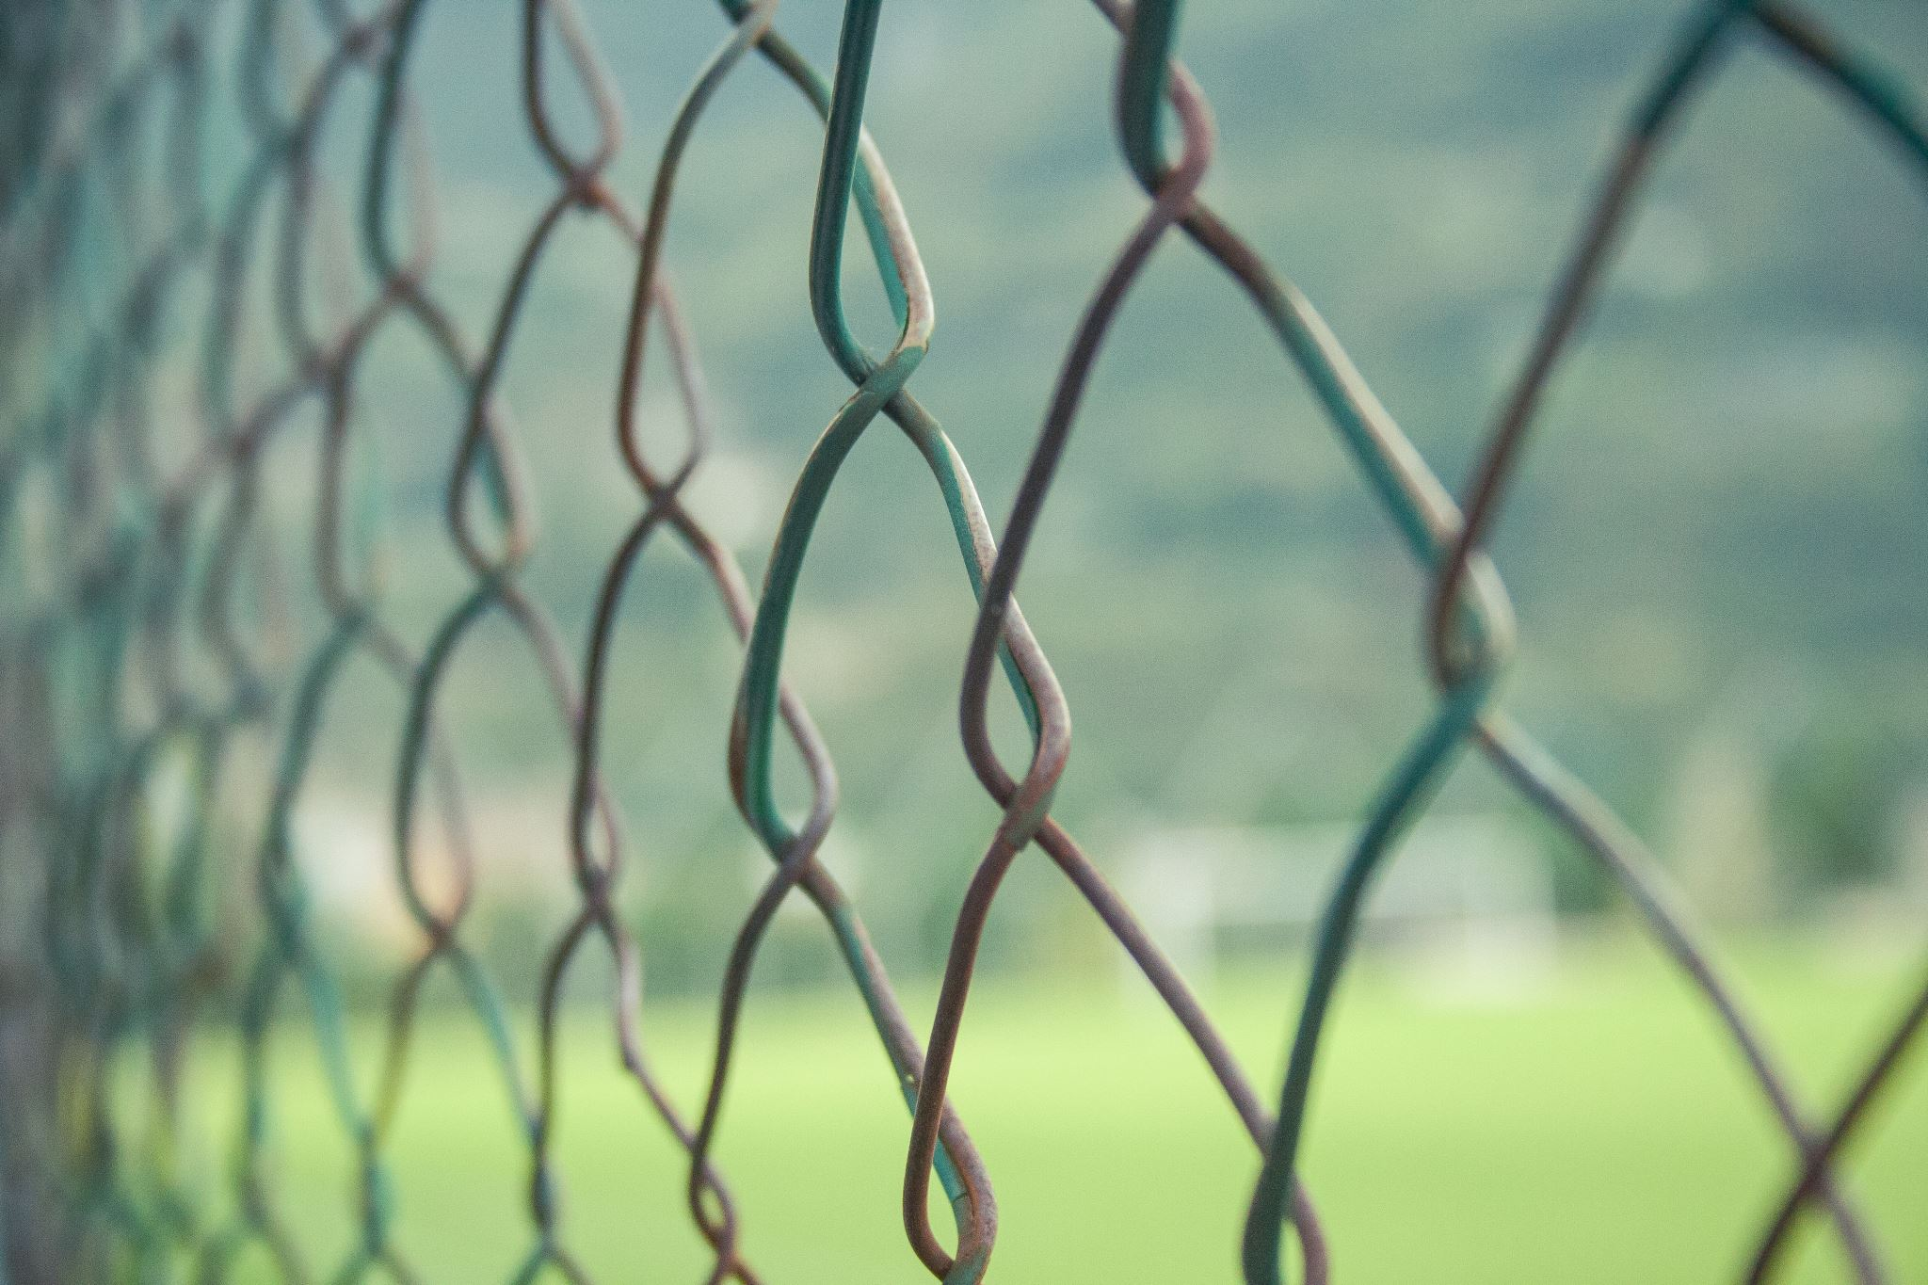
Rail Fence Cipher
Encryption:- Write the PT in a zig-zag manner based on the depth in a table. Number of Rows = depth and Number of Columns = len(PT). CT is obtained by reading the characters row-wise.
Decryption:- Initialize a blank table with Number of Rows = depth and Number of Columns = len(CT). Mark the zig-zag path by placing characters only in the first row till you reach the last column, by leaving rest of cells blank. Fill in the blanks by rest of the CT characters. PT is obtained by reading the characters in zig-zag manner.

Slide 100
Numerical 1
Encrypt the plaintext KANYAKUMARI using Rail fence cipher with a depth of 2.
Solution:-
The ciphertext is KNAUAIAYKMR
K |  | N |  | A |  | U |  | A |  | I
 | A |  | Y |  | K |  | M |  | R

Slide 101
Numerical 2
Decrypt the ciphertext KNAUAIAYKMR using Rail fence cipher with a depth of 2.
Solution:-
Iteration 1:-
K |  | N |  | A |  | U |  | A |  | I
 | _ |  | _ |  | _ |  | _ |  | _

Slide 102
Numerical 2 (Contd..)
Iteration 2:-
Therefore, the decrypted text is KANYAKUMARI.
K |  | N |  | A |  | U |  | A |  | I
 | A |  | Y |  | K |  | M |  | R

Slide 103
Numerical 3
Encrypt the plaintext VISHAKHAPATNAM using Rail fence cipher with a depth of 3.
Solution:-
The ciphertext is VAPAIHKAANMSHT
V |  |  |  | A |  |  |  | P |  |  |  | A
 | I |  | H |  | K |  | A |  | A |  | N |  | M
 |  | S |  |  |  | H |  |  |  | T

Slide 104
Numerical 4
Decrypt the ciphertext CUNOOPTREWRSMETK using Rail fence cipher with a depth of 3.
Solution:-
Iteration 1:-
C |  |  |  | U |  |  |  | N |  |  |  | O
 | _ |  | _ |  | _ |  | _ |  | _ |  | _ |  | _ |  | _
 |  | _ |  |  |  | _ |  |  |  | _ |  |  |  | _

Slide 105
Numerical 4 (Contd..)
Iteration 2:-
Therefore, the decrypted text is COMPUTERNETWORKS.
C |  |  |  | U |  |  |  | N |  |  |  | O
 | O |  | P |  | T |  | R |  | E |  | W |  | R |  | S
 |  | M |  |  |  | E |  |  |  | T |  |  |  | K

Slide 106
Pros and Cons of Rail Fence Cipher
Simple to understand and easy to implement.
Has got low computation cost.
Vulnerable to Statistical attack.
Vulnerable to Pattern attack.
Vulnerable to BFA.

Slide 107
COLUMNAR CIPHER

Slide 108

Columnar Cipher
Provides grid-based encryption and decryption.
The plaintext is written row-wise, and the ciphertext is generated by reading the plaintext characters column-wise.
The ciphertext is written column-wise in a certain order, and the decrypted text is generated by reading the ciphertext characters row-wise.
The key contains a sequence of numbers representing the order of columns.
Multiple stages can be used to enhance the security.

Slide 109
Processing the key
The key could either be represented as a sequence of numbers or as a text.
If the key is a text, then the text is converted into a sequence of numbers according their alphabetical order in the text.
The length of the key = number of columns.
Assume that the key is 4 2 1 3 5. This indicates that the grid consists of 5 columns.
If the key is hello, then the corresponding numerical sequence (permutation) will be 2 1 3 4 5.

Slide 110
Steps for Encryption
Number of Rows = Ceil(Length(PT)/Number of Columns)
Fill the grid row-wise with plaintext characters (At the end, fill any vacancy with ‘x’).
Obtain the ciphertext, by reading the plaintext characters column-wise according to the key permutation.
For example, a key having a sequence 3 1 2 indicates that the grid has 3 columns. Moreover, during CT calculation, the second column is read first, third column is read second, and the first column is read third.

Slide 111
Steps for Decryption
Number of Rows = Length(CT)/Number of Columns
Fill the grid column-wise with the Ciphertext characters according to the key permutation.
Obtain the decrypted text by reading the Ciphertext characters row-wise.
For example, if the key has a sequence 3 1 2, then the second column is filled first, third column is filled second, and the first column is filled third.

Slide 112
Numerical 1
Encrypt the plaintext GOCORONAGO using single stage columnar transposition with key HELLO.
Solution:-
HELLO → 2 1 3 4 5
Therefore, the Ciphertext is ONGOCAOGRO.
G | O | C | O | R
O | N | A | G | O

Slide 113
Numerical 2
Decrypt the Ciphertext ONGOCAOGRO using single stage columnar transposition with key HELLO.
Solution:-
HELLO → 2 1 3 4 5
IT1:-
 | O
 | N

Slide 114
Numerical 2 (Contd..)
IT2:-
IT3:-
Therefore, the decrypted text is GOCORONAGO.
G | O
O | N
G | O | C | O | R
O | N | A | G | O

Slide 115
Numerical 3
Decrypt the Ciphertext CALONAIXACEIEIEMUMHXAHXADFXYRPODTNG using double stage columnar transposition with key MANIPAL.
Solution:-
MANIPAL →
5 | 1 | 6 | 3 | 7 | 2 | 4

Slide 116
Numerical 3 (Contd..)
The decrypted text after first stage decryption:- ACFEOAMHAXIDIUXLYETXMAORINAHDNPEGCX.
5 | 1 | 6 | 3 | 7 | 2 | 4
A | C | F | E | O | A | M
H | A | X | I | D | I | U
X | L | Y | E | T | X | M
A | O | R | I | N | A | H
D | N | P | E | G | C | X

Slide 117
Numerical 3 (Contd..)
Now decrypt ACFEOAMHAXIDIUXLYETXMAORINAHDNPEGCX again.
The decrypted text after second stage decryption:- MANIPALACADEMYOFHIGHEREDUCATIONXXXX.
Hence, discarding the 4 ‘X’s at the end, the decrypted text is MANIPALACADEMYOFHIGHEREDUCATION.
5 | 1 | 6 | 3 | 7 | 2 | 4
M | A | N | I | P | A | L
A | C | A | D | E | M | Y
O | F | H | I | G | H | E
R | E | D | U | C | A | T
I | O | N | X | X | X | X

Slide 118
Pros and Cons of Columnar Transposition Cipher
Simple to understand and straight forward to implement.
Resistant to BFA if key is slightly long or longer.
More resistant to Statistical attack, when compared to Rail Fence, if (length of PT) mod (length of the key) is close to 0, but not equal to 0.
Resistant to Pattern attack, when long keys are used, with multiple stages.
Vulnerable to BFA if key is short.
Highly vulnerable to Statistical attack, if length(PT) is a multiple of that of the key.
Highly vulnerable to Pattern attack, when a short key is used, with a single stage transposition.
Use of multiple stages will reduce the efficiency when long PT is used.

Slide 119
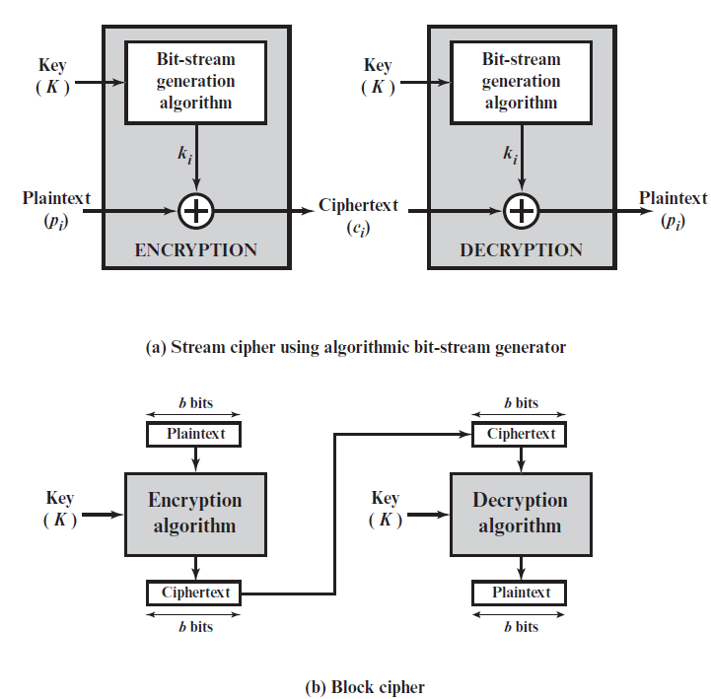
Stream Cipher and Block Cipher

Slide 120
Differences between Stream and Block Ciphers
Stream | Block
One Bit or Byte is processed (encrypted or decrypted) at a time | Fixed size block is processed at a time (64 bits, 128 bits, etc.)
Usually Variable Key size | A given algorithm will have a fixed key size
Padding is not required | Most probably requires padding
Processing is faster | Processing is slower
Error Propagation is limited | Error propagation could be significant and can produce a completely different output
Examples:- RC4, Rabbit, ChaCha, etc. | Examples:- AES, DES, Triple DES, Serpent, etc.
Used for real-time data stream encryptions and decryptions, where minimum latency is expected. | Used for applications which can handle large data chunks.

